Slide 1

ENGR 1624 - 12 Fall 2020
Cigar-box Violin Project
Team members:
Cameron Chiaramonte / Design
Nathan Patton / Building
Jose Vallarino / CAD

Slide 2
ENGR 1620 – 12 Fall 2014
Cigar-box Violin Project
Maple Wood Cigar Box
Dimensions: 9.75in X 7.00in X 3.44in (L X W X H)
Wall thickness – 0.25in
Bottom thickness – 0.25in
Top thickness – 0.19in
Challenges
Altering the thickness of the walls of the box in CAD
Designing and implementing the holes in CAD
Decided to use a different box

Slide 3
ENGR 1620 – 12 Fall 2014
Cigar-box Violin Project
To perform mode analysis Audacity and Autodesk Inventor were used.
Inventor used a stress analysis simulation
Audacity graphed the frequency based off the noise produced from tapping the wood

Slide 4

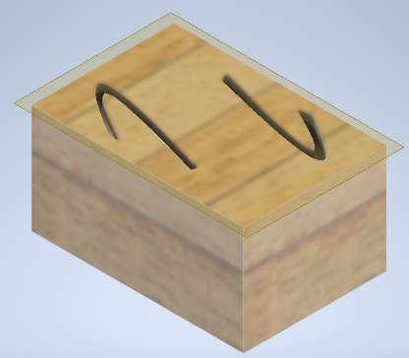
ENGR 1620 – XXX Fall 2014
Cigar-box Violin Project
The Original Plan:
The box shown below was our original idea
A few problems arose
The box was very small
The holes were “squeezing” the frequency together and
only made it worse

Slide 5
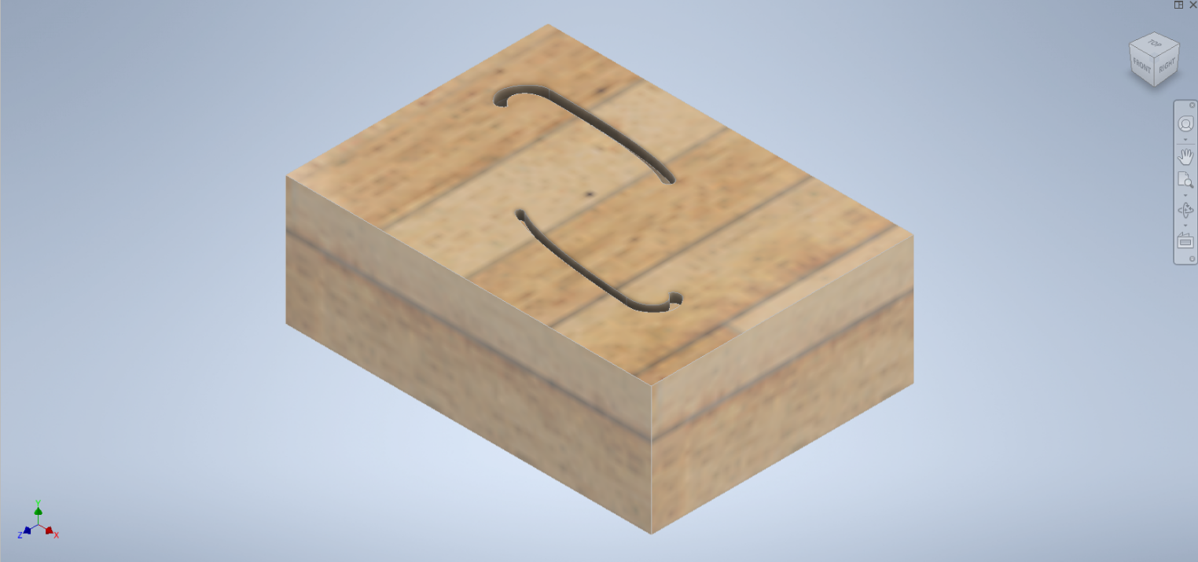
ENGR 1620 – 12 Fall 2014
Cigar-box Violin Project
New Plan:
The new box was much flatter (dimensions shown on first slide)
The new holes minimized our frequency to our desired range

Slide 6
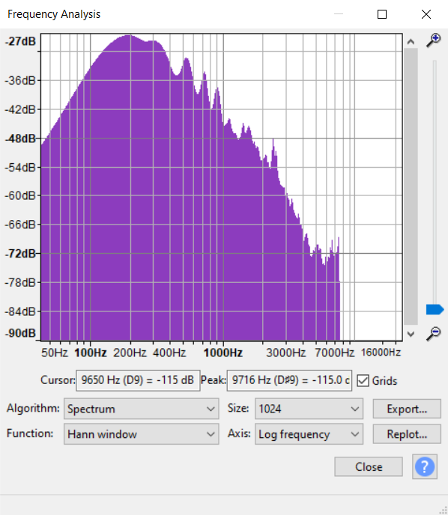
ENGR 1620 – 12 Fall 2014
Cigar-box Violin Project
Audacity frequency analysis of the blank box
Shown below as both the range from Audacity and as a graph from the exported data
Can see the peak very early on at around 300 Hz

Slide 7
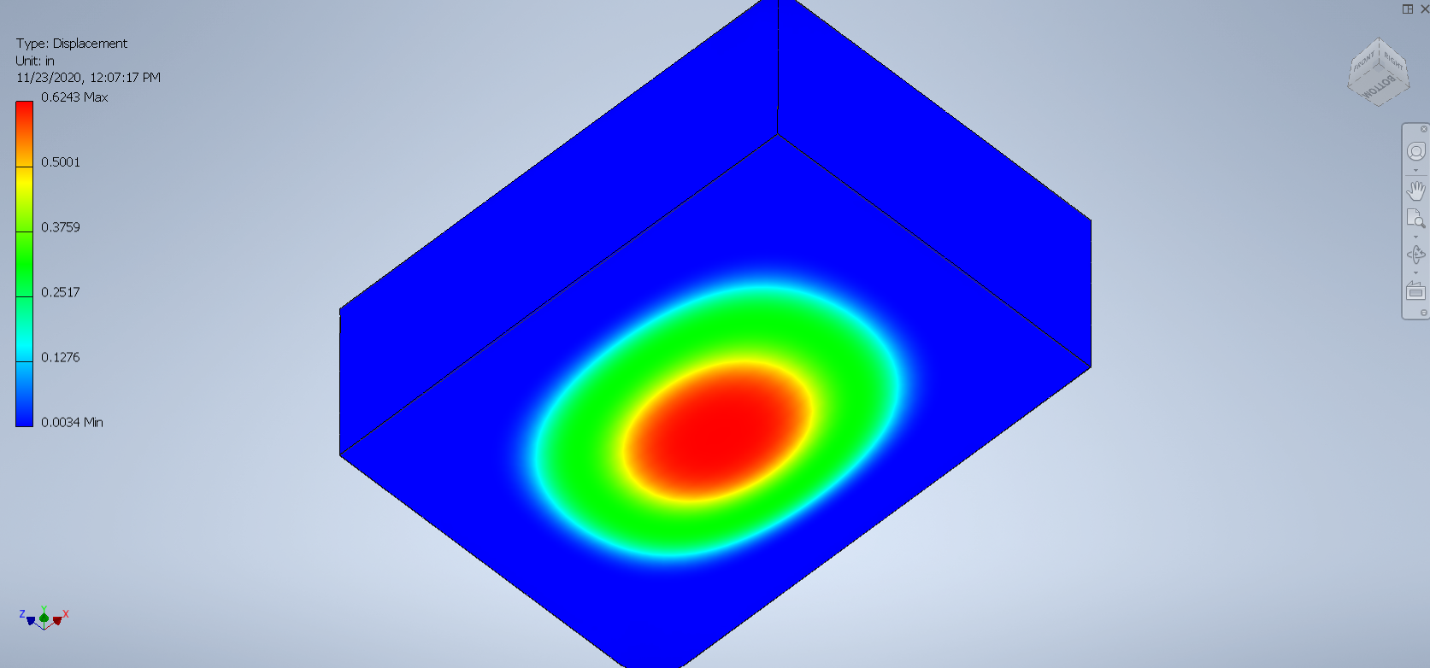
ENGR 1620 – 12 Fall 2014
Cigar-box Violin Project
Inventor Stress Analysis of Blank Box
First peak at around 700 Hz

Slide 8
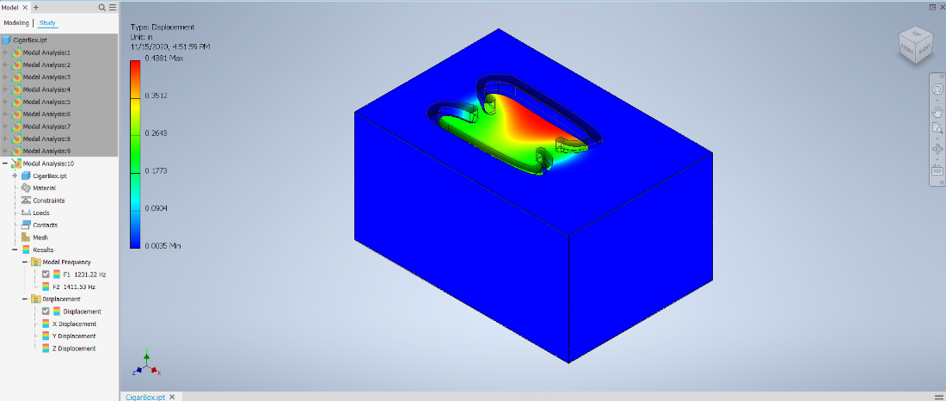
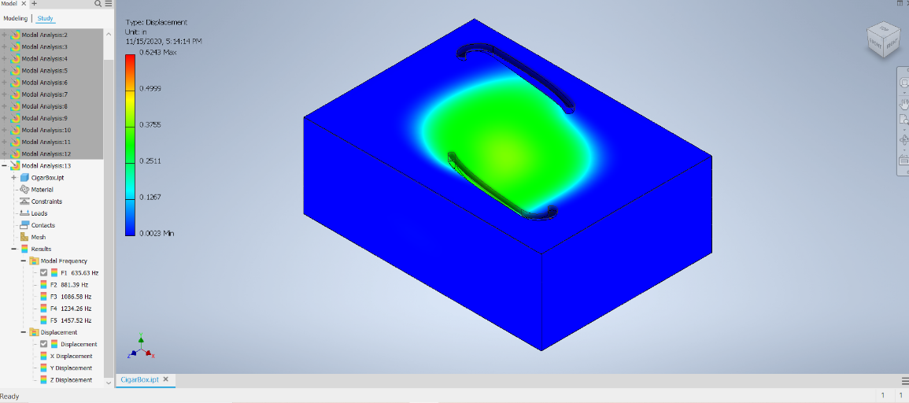
ENGR 1620 – 12 Fall 2014
Cigar-box Violin Project
Inventor Stress Analysis of Original and Final Holes
Original holes – 1231.22 Hz
Final holes – first peak at 635.63 Hz

Slide 9
ENGR 1620 – 12 Fall 2014
Cigar-box Violin Project
The Product:
Why we chose what we did
Holes – these holes are very similar to actual f holes
on a real violin
They also reduced our frequency more than other holes
we attempted to use
Using Professor Williams’ advice we put them in opposite
corners to further minimize the frequency range

Slide 10
ENGR 1620 – 12 Fall 2014
Cigar-box Violin Project
The Product:
Why we chose what we did
The box
The flatter box gave much better sound than
our original small and tall box

Slide 11
ENGR 1620 – 12 Fall 2014
Cigar-box Violin Project
The Product:
Why we chose what we did
The strings
We used only three strings
This just worked better with the shape and size
of our box

Slide 12
ENGR 1620 – 12 Fall 2014
Cigar-box Violin Project
Our Plan:
CAD the box and find holes that will get us to a desired frequency
Draw and cut out the holes in the box
Make the finger board, the bridge, and the tail piece
Glue on all the pieces from step 3
Attach strings to the violin
Tune

